Slide 1


Slide 2
My e-Shop with Employee Management
Project Name
Trainee Name: Md.Rakibul Hasan
Trainee id: 1238174
Batch Id: ESAD/J2EE/APCL-M/34/01

Slide 3
OBJECTIVES:
1.Add Employee
2. Manage Employee
3.Product Management
4.Stock Maintained
5.Quick Selling System
6. Database System Implemention

Slide 4
Opening

Slide 5
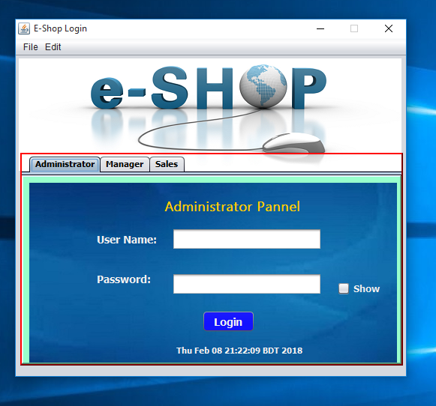
Login Window

Slide 6
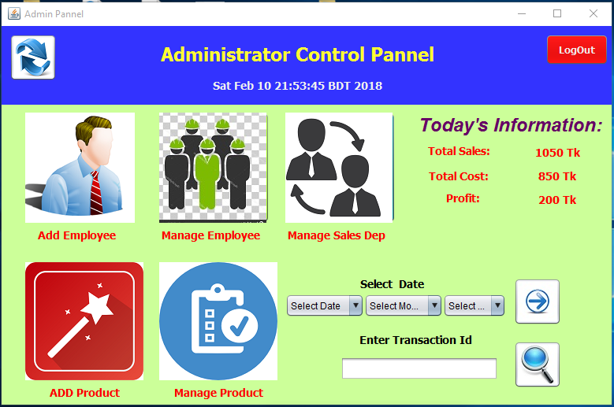
Admin Panels

Slide 7
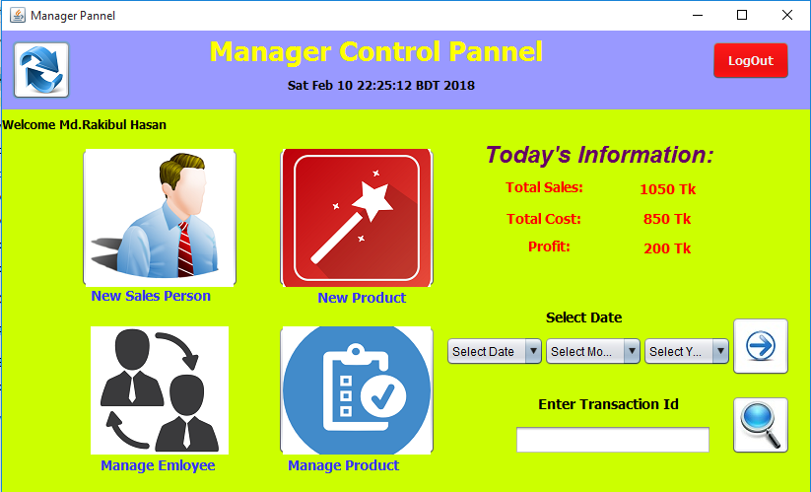
Manager Panels

Slide 8
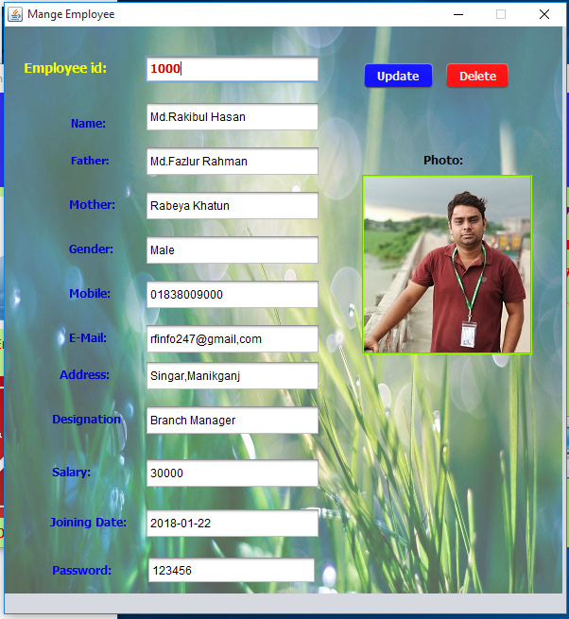
Manage Employees

Slide 9
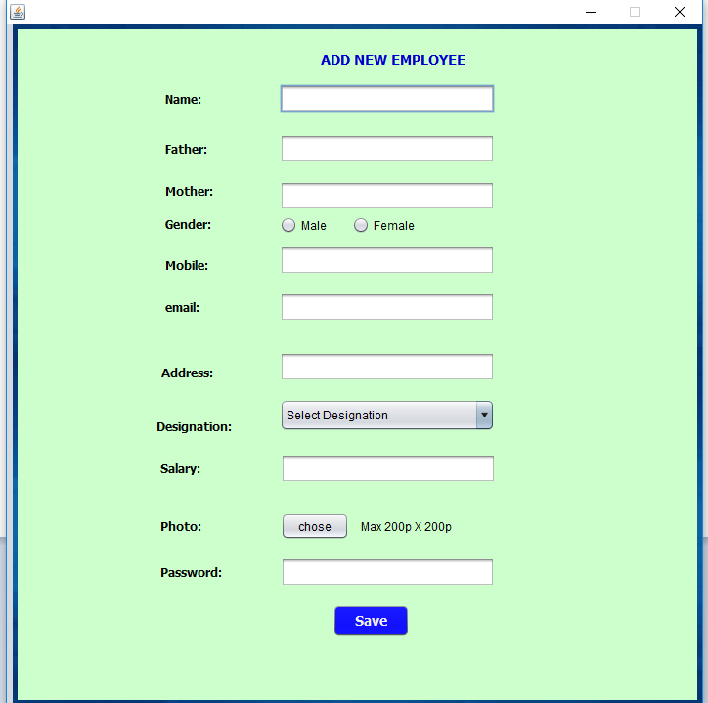
Add New Employee

Slide 10
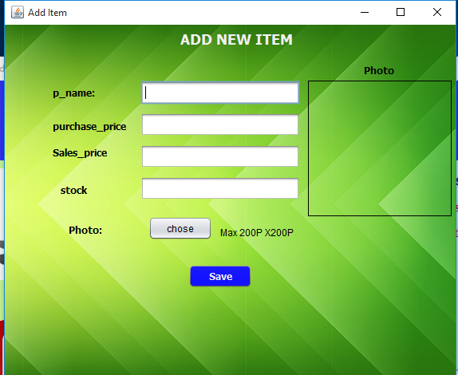
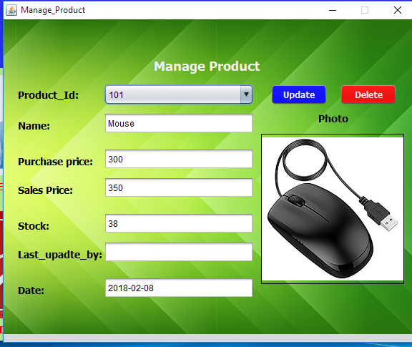
Add And Manage Product

Slide 11
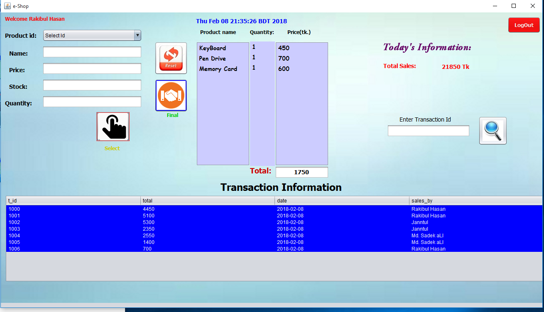
Selling Interface

Slide 12
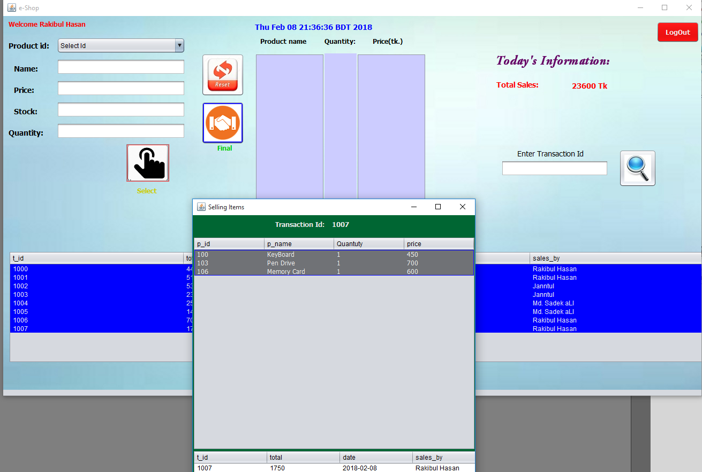
Creating Transaction

Slide 13
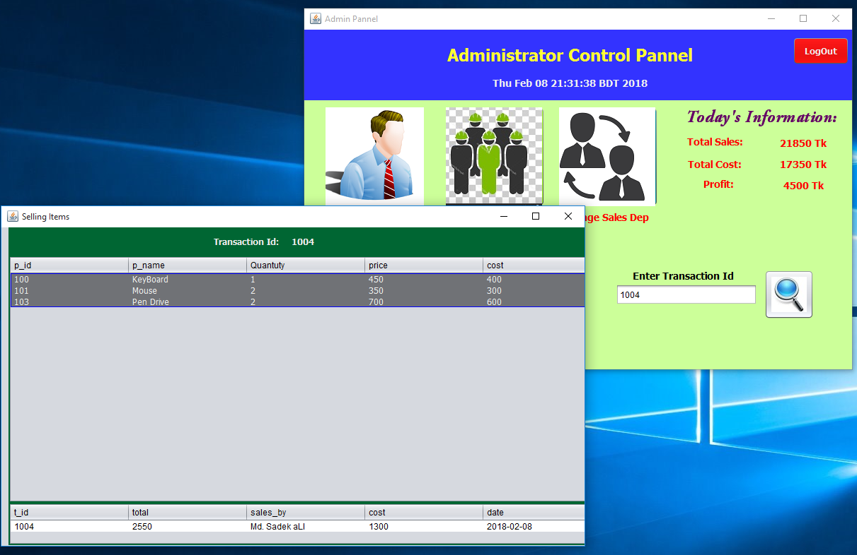
Search Transaction

Slide 14
Automatic Today Profit

Slide 15
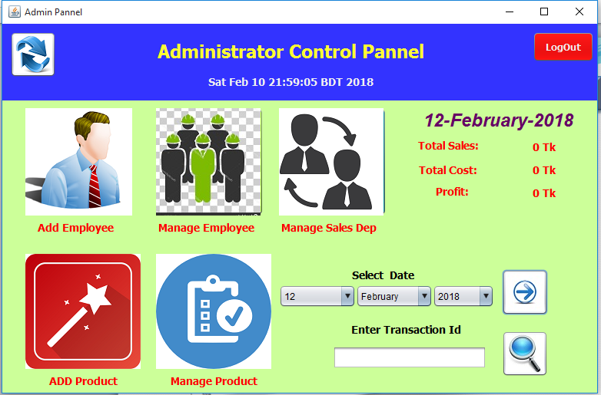
Profit Search By Date

Slide 16
Using Technology
JAVA
Jdk
NetBeans IDE
Oracle
MySQL
MySQL Workbench
JAVA Swing

Slide 17
Thank you

